Slide 1
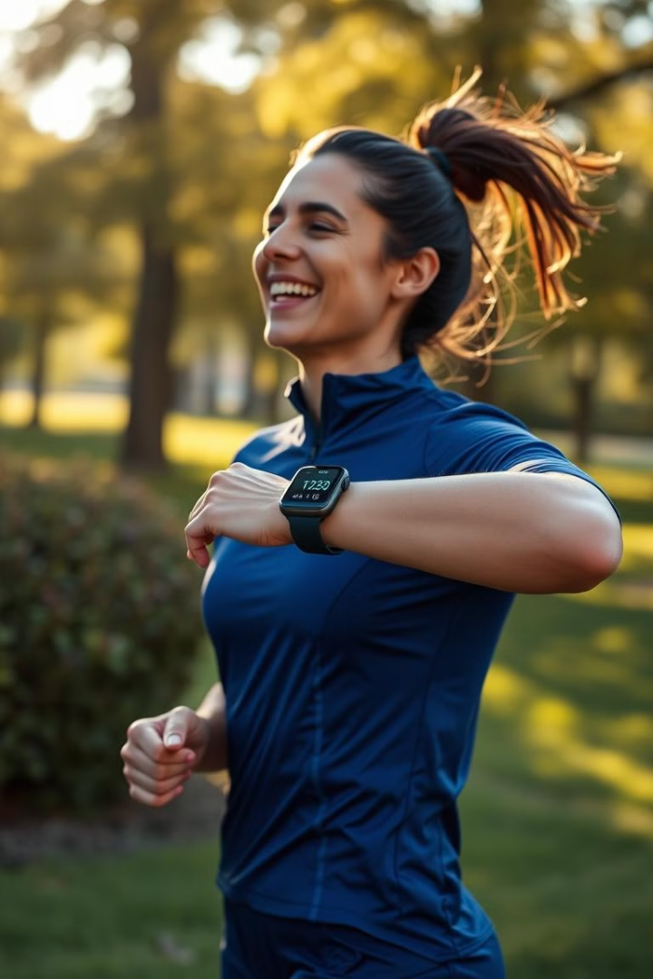
Personal Fitness Tracker Using Machine Learning
An AI-driven approach for personalized fitness monitoring.

Slide 2

Problem Statement
Many fitness apps rely on generic calorie estimations.
Inadequate tracking of calorie expenditure.
Need for real-time, personalized tracking based on vital signs.
Lack of accuracy due to individual differences.

Slide 3

Proposed Solution
1
AI-Based Tracker
2
Machine Learning
Personal Fitness Tracker for real-time monitoring.
Utilizes ML models (SVM, Logistic Regression, Random Forest).
3
Personalized Predictions
Provides tailored calorie predictions based on user parameters.

Slide 4





Software Requirements
Scikit-learn
Python 3.8+
2
Implements the ML model (SVM) for personalized predictions.
The core programming language for developing the AI model.
1
Streamlit
3
Creates the web UI for user interaction and data input.
Pickle
5
Pandas, NumPy
Serializes the ML model for deployment on the fitness tracker.
4
Handles data manipulation for model training and usage.

Slide 5
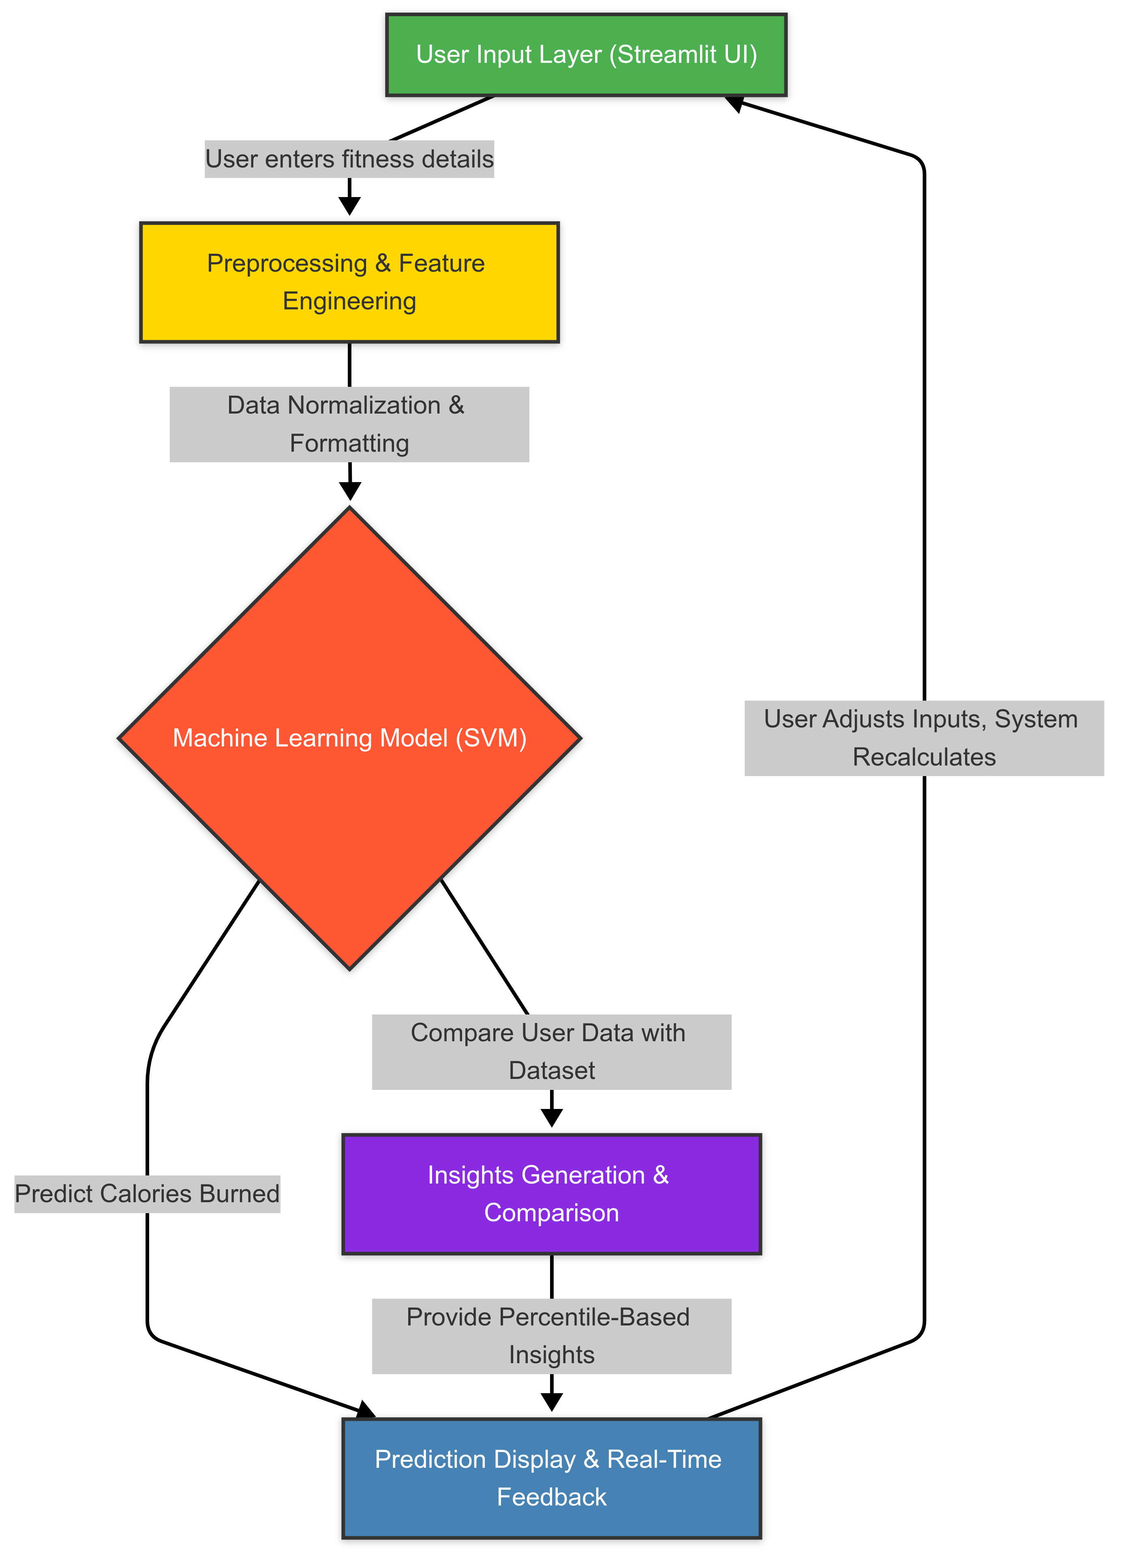





System Architecture
Data Collection
Fitness dataset from Kaggle.
Data Preprocessing
Handling missing values & normalization.
Feature Selection
Extracting key features like heart rate.
Model Training
Train and optimize ML models.
Deployment
Convert model to Pickle format, integrate with Streamlit UI.

Slide 6
Working Flow
Input Fitness Details
1
Users provide key data: age, height, weight, and activity level.
2
Data Preprocessing
Data is cleaned, normalized, and formatted for the ML model.
Calorie Prediction
3
SVM model predicts calorie expenditure based on user input.
4
Insight Generation
Comparisons with dataset generate personalized insights.
Real-Time Display
5
Results are displayed to the user in real-time.

Slide 7

Future Scope
IoT Integration
Dataset Expansion
ML Model Addition
Integrate with wearables (smartwatches, fitness bands).
Expanding dataset for higher accuracy.
Adding more ML models for better predictions.

Slide 8
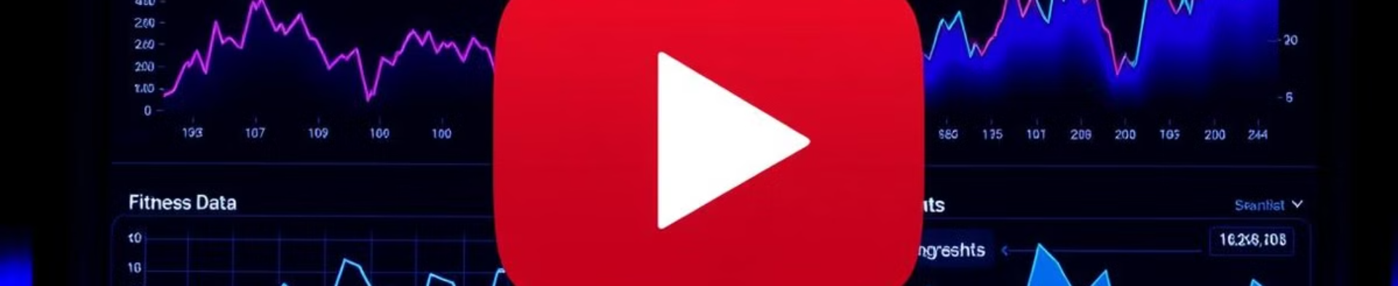
Video Demonstration
Watch the AI-driven personal fitness tracker in action.
See real-time health monitoring and personalized calorie predictions.
Link to the Video: https://youtu.be/U9Bp8s7MX24?si=j4iOc09TXnsqSVw9

Slide 9

Thank You!
Contact me for questions or collaboration.
Name: Avijit Pakhira
Email: avijitpakhira2807@gmail.com
LinkedIn: https://www.linkedin.com/in/avijit-pakhira-8541841ba/
GitHub: https://github.com/avijit-28

